Slide 1
Introduction to C++

Slide 2
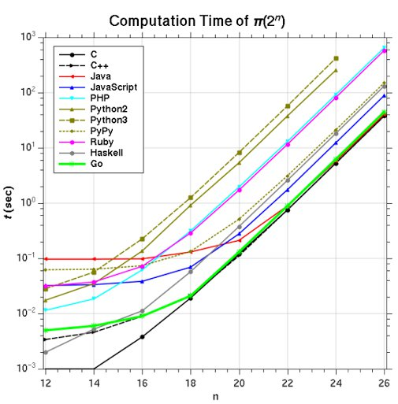
C++ Preference over other languages:
Portable: We can use the same compiler across different platforms (macOS, Win), not like Java(JDK is platform dependent, but not JRE though)
Object Oriented Programming: A big leap over ‘C’, allow code reusability and makes a program even more reliable
Low-Level Manipulations: Browser based services (‘libuv’ in node is in c++) etc.,
Large community for better improvements and query resolutions
C++ is a ‘compiler’ based language (code is preprocessed -> compiled -> linked -> loaded)
Fast and efficient ( C > C++ > Java >>> Python)
Availability of ‘Standard Template Library (STL)’ makes it one of the best language for Competitive programmers

Slide 3
Math functions:
A math function needs inputs and returns an output
In addition to human mathematics, machines also need to know about the details of the inputs/outputs being passed
So, Function requirements:
A Name
Inputs (If Any)
Outputs (If Any)
Of Course, what are the input/output types the function is expecting or returning

Slide 4
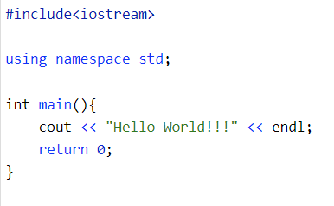
First Program – ‘Hello World’
We have to import libraries
Define ‘using’ the namespace in which the library is written in
Write main function (void or int)
‘cout << ---- ;’ to print a new line on to the screen
‘endl’ specifies the program to print a new line on to the screen
‘return ---’ statement returns the value to the function caller (return type at the start of the function had to be matched with return type at the end.
‘{…}’ is a block of code (defines the scope*)

Slide 5
Including Header files (just like imports in python)
iostream – input output streaming functions (cin & cout)

Slide 6
Including Header files doesn’t guarantee the successful import of the library
We also have to specify the namespace in which the library is present (written)
BTS standard library (which has codes for ‘cin’, ‘cout’) are declared inside ‘std’ namespace. So, we have to use namespace std for using cin, cout.

Slide 7
Your code…
‘main’ is function name, ‘int’ is return type
It is mandatory that every C++ program should have ‘the’ ‘main’ function bcz main is the designated entry point of the compilation of your program (remember ‘compilation’, not the entire program)

Slide 8
Function name
Return Type

Slide 9
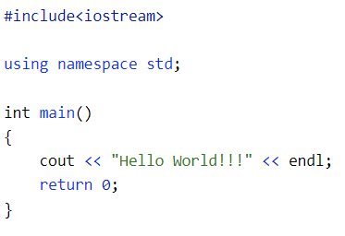
Function Logic
Function logic start (scope-’{‘)
Function logic start (scope-’{‘)

Slide 10
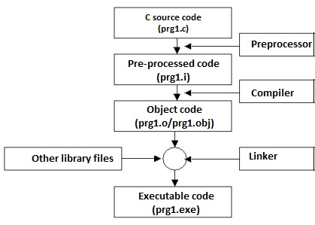
‘main’ -> starting point of execution for our program (doesn’t mean the first code ran by the CPU)
‘Pre-Processor’ expands the code by expanding the macros, includes the header file
‘Compiler’ then compiles the code by converting the high level code to machine level code (assembly code)
‘Linker’ then resolves the references that were placed by the compiler. Finally, generates an .exe file
‘Loader’ then loads the .exe file to main or primary memory

